Slide 1
People in our organization use SharePoint because:
I make them
IT makes us
They love it!
Notes:
First page – to be configured as a section (as opposed to modal or page with separate URL). Only this section displays until “I make them” or “IT makes us” selection is submitted.
On selection of “They love it!” – dynamically display message – Congratulations! You are part of the 1%. But if you’re not quite sure, make another selection and continue to read the story. Include graphic element or treatment for visual appeal and interest.
Once click of “I make them” or “IT makes us”, modal is suppressed and does not display again within the browser being used, unless user hard clears browser data.
Request for option to directly send users to one path or the other (as though the selection had already been made) – for example, with email blast, targeted promotional material.
***
For context, site entry points include:
Direct click – received URL from sales or an outside source, bookmark
Referral traffic (blog, email blast)
Public site service offering (Workforce Productivity, Roadmap – review with Mike D.)
Social posts
Organic search

Slide 2
HOME CHALLENGE SOLUTION PORTFOLIO GET STARTED
SHAREPOINT
A HERO’S TALE
Are you ready to go from scapegoat to hero?
Notes:
Theme:
http://tahoepartnerssolutions.com/dev/bs/
SharePoint Self-Assessment displays if IT owner.
EC Maturity Self-Assessment displays if Business owner.
What displays if anonymous visitor (persona unknown; for example – arrived through organic search)?
On click to take assessment, user is taken to assessment URL.
SP 2013 assessment - http://www.tahoepartners.com/pages/assessment.aspx
EC Maturity assessment – TBD (not live yet)

Slide 3
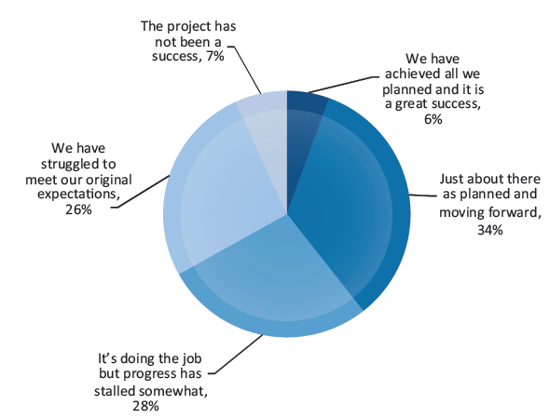
HOME CHALLENGE SOLUTION PORTFOLIO GET STARTED
PROBLEM IMPLICATION TRENDS
If it’s any consolation, you’re not alone.
No doubt about it – you’re not alone.
Implementing SharePoint can be challenging.
A 2013 Industry Watch Report from AIIM found that 61% of SharePoint ECM projects had stalled or did not meet expectations.
And, as an IT leader, you’ve heard the complaints ….
CHALLENGE
PROBLEM
Notes:
Replace existing pie chart with mobile-friendly graphic that leverages the statistics to communicate that 60% of SharePoint Enterprise Collaboration stalled or did not meet expectations. For example, can show a chart that combines the 6% and 34% “success slices” into 40% – with a label like “Achieved all of our goals or just about there.” And then shows slices for:
Not a success – 7%
Struggled to meet expectations – 26%
Doing the job, but progress has stalled – 28%
If chart is used, need to confirm number (do not currently sum to 100) and add title like “How’s Your SharePoint Project Going?”
Alternatively, can look to use our SharePoint 2013 report, manipulate as needed.

Slide 4
HOME CHALLENGE SOLUTION PORTFOLIO GET STARTED
PROBLEM IMPLICATION TRENDS
If it’s any consolation, you’re not alone.
CHALLENGE
You get SharePoint live, but users still aren’t happy. “SharePoint isn’t easy to use.”
“I can’t find what I’m looking for.”
“It doesn’t make me more productive. It actually makes my job harder.”
Then your IT team weighs in: “This is a mess. I can’t support it.”
And there is the future to consider …
IMPLICATION
Notes:
Imagery that communicates “scapegoat”.

Slide 5
HOME CHALLENGE SOLUTION PORTFOLIO GET STARTED
PROBLEM IMPLICATION TRENDS
If it’s any consolation, you’re not alone.
CHALLENGE
Future trends compound the challenges.
Millennials will soon make up 75% of the workforce.
Tablets are outselling PCs and smart phones are ubiquitous.
Social technology has changed the way people interact
Becoming the hero will only get harder.
Where can you go from here?
TRENDS
Notes:
Imagery that resonates with the topics of millennials and social and mobile technology.

Slide 6
(Continued from above)
GET READY FOR MILLENNIALS
by Mike Davidson – Apr 2, 2014
FUTURE OF THE KNOWLEDGE WORKER by David Sidwell – Mar 17, 2014
GOODBYE INTRANET. HELLO TO THE NOWENTERPRISE
By Ralph Keipert – Jan 13, 2014
Subscribe to our Blog
Notes:
On click to access a blog article, the URL for the selected article opens in a new window / browser tab.
Millennials blog article URL:
http://blog.tahoepartners.com/index.php/career-development-millennials-nowenterprise-next-generation/
Knowledge Worker blog article URL:
http://blog.tahoepartners.com/index.php/future-knowledge-worker-nowenterprise/
Goodbye Intranet blog article URL:
http://blog.tahoepartners.com/index.php/intranets-say-hello-nowenterprise/
Require ability to add / change blog articles over time. Will start with two, may add further articles overtime (scrolling through more than 2 may be a lot for mobile).

Slide 7
X
POWER UP – Become TahoeSmart!
Sign up to receive weekly industry updates, insights, and more.
Interests:
☑ SharePoint
□ Workforce Productivity
□ Customer Engagement
□ Healthcare
Email*
First Name
Last Name
Your Phone
Your Company
Power Up Now!
Notes:
BLOG SUBSCRIPTION (LIGHTBOX) CUSTOM DEVELOPMENT
On close of the modal, user is returned to main page.
“Subscribe to blog” CTA – consider use of option similar to Jetpack plug-in used for WordPress blog. Collect email within modal or within screen. (Christie work with Mike D.)
If modal, can we also optionally collect FN, LN, company and interest(s) – SharePoint, Workforce Productivity, Customer Engagement, Healthcare [multi-select allowed / checkboxes]. Only email would be required. Default SharePoint to checked.
On click to subscribe, combine / store email address in WordPress.

Slide 8
HOME CHALLENGE SOLUTION PORTFOLIO GET STARTED
ANSWER BENEFITS HOW WHAT
If it’s any consolation, you’re not alone.
“… it became apparent that we needed to construct a strategy before we started talking about long-term funding much less executing anything.”
SOLUTION
Can you go from SharePoint scapegoat to hero and save the day? Yes you can!
The answer starts with an Enterprise Collaboration Roadmap.
Galvanize your organization around a common set of priorities and set a course for high adoption. It’s amazing what buy-in and alignment can do.
READ HOW ONE CLIENT DID IT
ANSWER
Notes:
“Read how one client did it.” - links to No Enterprise Collaboration Strategy? Ready, Fire, Aim! blog article: http://blog.tahoepartners.com/index.php/enterprise-collaboration-strategy-ready-fire-aim/
On click to access the blog article, the URL for the selected article opens in a new window / browser tab.

Slide 9
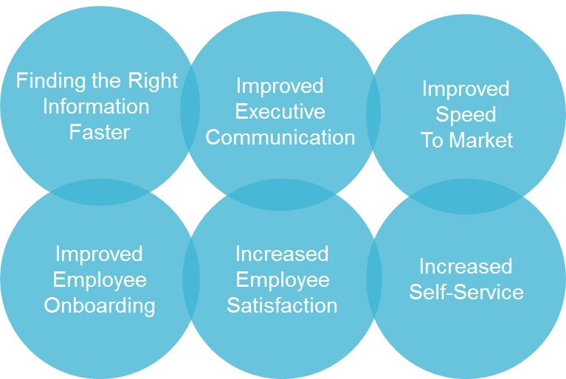
HOME CHALLENGE SOLUTION PORTFOLIO GET STARTED
ANSWER BENEFITS HOW WHAT
What happens when you build from an Enterprise Collaboration roadmap:
If it’s any consolation, you’re not alone.
SOLUTION
Being the hero is always better than being the scapegoat.
When you plan ahead and start SharePoint projects from an enterprise collaboration roadmap, adoption increases and your stakeholders are aligned.
It doesn’t take much to get started…
BENEFITS

Slide 10
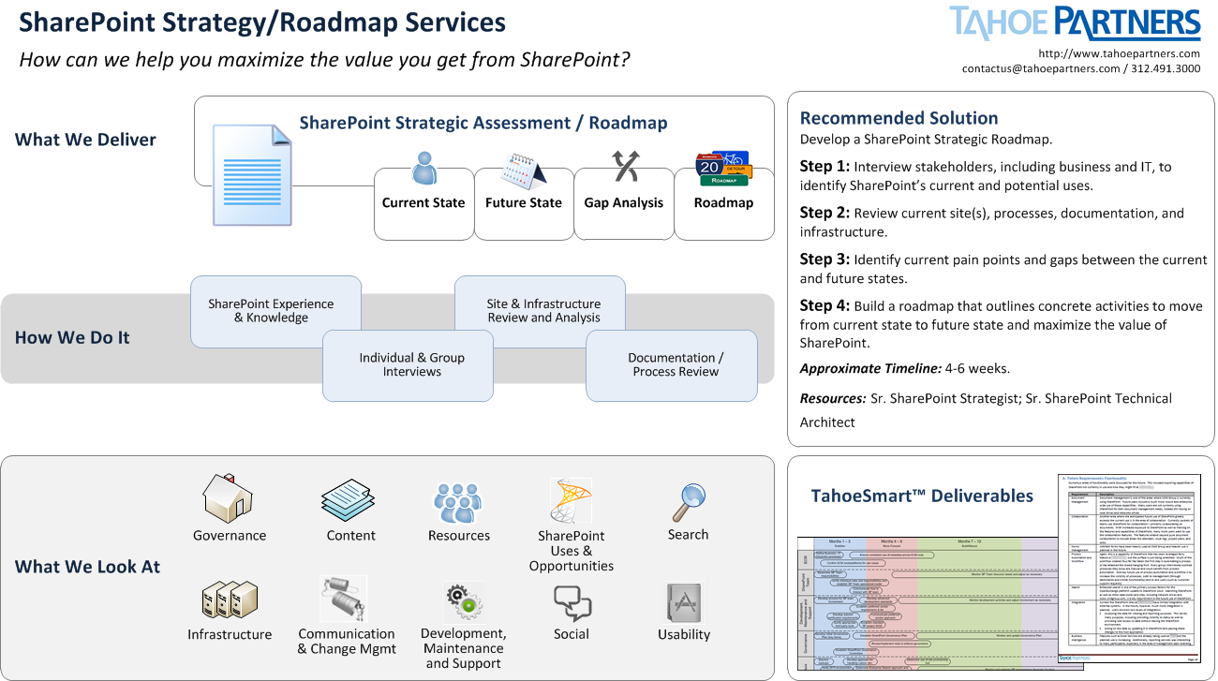
HOME CHALLENGE SOLUTION PORTFOLIO GET STARTED
ANSWER BENEFITS HOW WHAT
SOLUTION
Start with where you are.
The process of developing a roadmap means taking stock of your current state – your sites, tools, infrastructure, and processes, leveraging best practices and our experience to help define your vision for the future, and prioritizing the initiatives required to move forward.
HOW IT
WORKS
Notes:
No share capability.
Reduce roadmap to just a few sections – What We Deliver, How We Do It, What We Look At.
Display embedded within the page through one to two panels or a slide share with two frames. Interactivity not required.
Streamline content; assess options for “mobile friendliness” (Christie / Melanie work with Creative Team)

Slide 11
HOME CHALLENGE SOLUTION PORTFOLIO GET STARTED
ANSWER BENEFITS HOW WHAT
SOLUTION
Turn Roadblocks into Building Blocks
Your roadmap creates a clear path to the future vision for your SharePoint strategy. With solutions defined for each component, along with steps to achieve each goal, you will have the background to guide your organization in taking the right steps at the right time in the journey. And to become a SharePoint hero!
WHAT IT
COVERS
Notes:
No share capability.
Reduce roadmap to just a few sections – What We Deliver, How We Do It, What We Look At.
Display embedded within the page through one to two panels or a slide share with two frames. Interactivity not required.
Streamline content; assess options for “mobile friendliness” (Christie / Melanie work with Creative Team)

Slide 12
(Continued from above)
COLLABORATION STRATEGY & ROADMAP
by David Sidwell – Jun 17, 2013
COLLABORATION OBSTACLES by Ralph Keipert – Jun 26, 2013
COLLABORATION: USER EXPERIENCE, RESILIENT DESIGN
by Mike Davidson
Subscribe to our Blog
Notes:
On click to access a blog article, the URL for the selected article opens in a new window / browser tab.
Strategy & Roadmap blog article URL:
http://blog.tahoepartners.com/index.php/enterprise-collaboration-strategy-and-roadmap/
Collaboration Obstacles blog article URL:
http://blog.tahoepartners.com/index.php/enterprise-collaboration-obstacles-breaking-down-organizational-silos/
Collaboration UX, Resilient Design URL:
http://blog.tahoepartners.com/index.php/enterprise-collaboration-user-experience-and-change-resilient-design/
Require ability to add / change blog articles over time.
Subscribe functionality – see notes with slide #7.

Slide 13
HOME CHALLENGE SOLUTION PORTFOLIO GET STARTED
OUR CLIENTS, OUR HEROES
REYES HOLDINGS
Here's an origin story for you: what started as a simple request for document management evolved into a roadmap for the next three years.
HURON CONSULTING
What does an award-winning intranet look like? Like increasing usage by 86% and tripling the number of content contributors.
HOLLISTER
Where does an Enterprise Collaboration roadmap take you? At Hollister, all over the world.
NAVISTAR
Finding thousands of untapped employee ideas - and uncovering 5.3MM in savings. That's pretty heroic.
Notes:
Distinguish roadmap clients from implementation clients. Use image area to convey (for example – with an icon)? Roadmap clients – Reyes, Hollister.
On click to view a case study, a modal opens and displays details about the selected study.
Visually distinguish clients for which Tahoe Partners produced a roadmap (1st step) and those with which TP worked to implement from a roadmap (2nd step – derive business value from road map). Roadmap produced for: Reyes, Hollister, Protective
Concern with 6 – 7 pieces being a lot for mobile (vertical scroll).

Slide 14
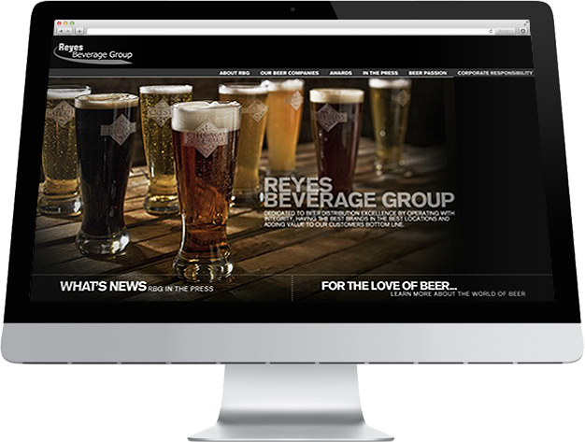
X
REYES HOLDINGS
Heroic Feats
4 major areas of recommendation
SharePoint vision and governance
Platform and feature consolidation
Heroic Feats
4 major areas of recommendation
SharePoint vision and governance
Platform and feature consolidation
A three-year roadmap aligned the organization around collaboration priorities for over 15,000 global employees, many of them mobile. Intranet redesign and document management were two early high priority areas.
Notes:
WORK DETAIL (LIGHTBOX) CUSTOM DEVELOPMENT
On close of the modal, user is returned to main page.
Text for Hollister:
15 global departments interviewed
4,500 users
50+ interview participants
A multi-year roadmap for this global organization will lead to a common collaboration environment. Early priorities included a redesigned intranet, multi-lingual, personalization, social, content governance and robust search.
Text for Huron:
86% increased usage
300% increase in content contributors
This $700 M professional services firm sough to increase adoption of its intranet and, as a result, workforce productivity. Nielsen Normal recognized this intranet as one of the ten best of the year.
Text for Navistar:
1,800 new ideas
5.3 MM in savings in 1st 6 months
This $13 B global manufacturer sought to foster communication through social business across its 14,000 employees. Finding internal experts quickly and cultivating employee ideas that drive bottom line results were high priority objectives.

Slide 15
(Continued from above)
NAVISTAR
HERO CASE STUDY
HOLLISTER
HERO CASE STUDY
PROTECTIVE
HERO CASE STUDY
Notes:
WORK DETAIL (LIGHTBOX) CUSTOM DEVELOPMENT
User has ability to select to view another portfolio piece.

Slide 16
HOME CHALLENGE SOLUTION PORTFOLIO GET STARTED
GET YOUR CAPE
SharePoint 2013 Self Assessment
Can SharePoint 2013 help you deliver heroic benefits to your enterprise?
Get Our Report
Prepare to save the day. Learn how organizations plan to use SharePoint 2013.
Go
See the Results
Notes:
CTAs displayed vary by persona type (IT Owner, Business Owner).
IT Owner - SP 2013 Assessment and Download Report
Business Owner – EC Maturity and Download White Paper
On click to take the SP 2013 assessment, a new browser window / tab opens and user is taken to: http://www.tahoepartners.com/pages/assessment.aspx
On click to download the SP 2013 assessment, the user is prompted to provide an email address and the report document is automatically emailed to that address.
OPEN: Confirm approach to take to provide email prompt and confirmation to the user that the request has been received, email is on it’s way.
On click to take the EC Maturity assessment, a new browser window / tab opens and user is taken to: URL TBD (not yet live)
On click to download the EC white paper, file download / prompt and/or email with white paper attached.
Need to confirm how email will be captured (in screen, through modal) and where / if it will be stored. (Christie work with Mike D.)
Following launch, consider A/B Test to confirm:
how IT owners respond to the SP 2013 CTAs vs EC Maturity CTAs.
impact of alternate positions.
EC Maturity Assessment with NE report

Slide 17
X
POWER UP – Get the Report!
Email*
First Name
Last Name
Your Phone
Your Company
Power Up Now!

Slide 18
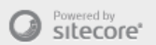
HOME CHALLENGE SOLUTION PORTFOLIO GET STARTED
WE’D LOVE TO HEAR FROM YOU
Inquiry Type:
General
Careers
SEND A
SIGNAL
First Name*
Last Name*
Email*
Your Phone
312.491.3000
Your message ….
Send Message
© 2014 Tahoe Partners
Notes:
Social media reference at bottom of the page – Twitter, LinkedIn, G+, blog.
To where does form data submit / store?
Consider including:
(External to site, but as part of overall effort) links to EC microsite from other Tahoe Partners digital properties (SP 2013 / EC maturity assessments, Tahoe public site, blog). Yes – positioning (rhetorical and physical TBD).

